Slide 1

Cardiovascular Disease
By: Mithil Patel

Slide 2
The Big Question
According to World Health Organization (WHO), the leading cause of death in the world is cardiovascular disease, accounting for 16% of total death.
With more than 2 million to 8.9 million deaths in 2019, the question is ought to be asked:
What are the attributes related to cardiovascular disease? In other words, which characteristic shave a profound influence, good or bad, on cardiovascular disease?

Slide 3
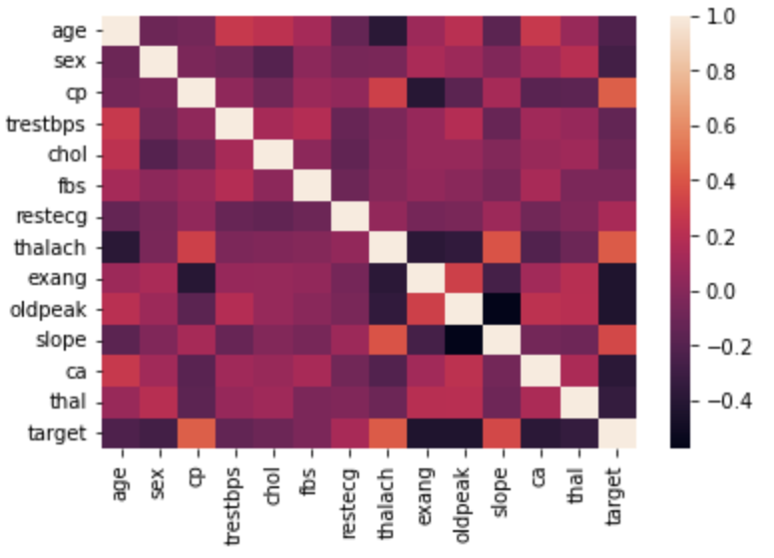
Five Possible Attributes
The correlation heat map can be used to determine the variables relevant to the cardiovascular disease.
Variables with correlation value above 0.25 and below
-0.25 will be consider in our analysis.
Variables
cp: chest pain type
thalach: Maximum heart rate
exang: exercise induced severe chest pain
oldpeak: ST segment
slope: peak exercise ST segment slope
target: heart disease is present or not

Slide 4
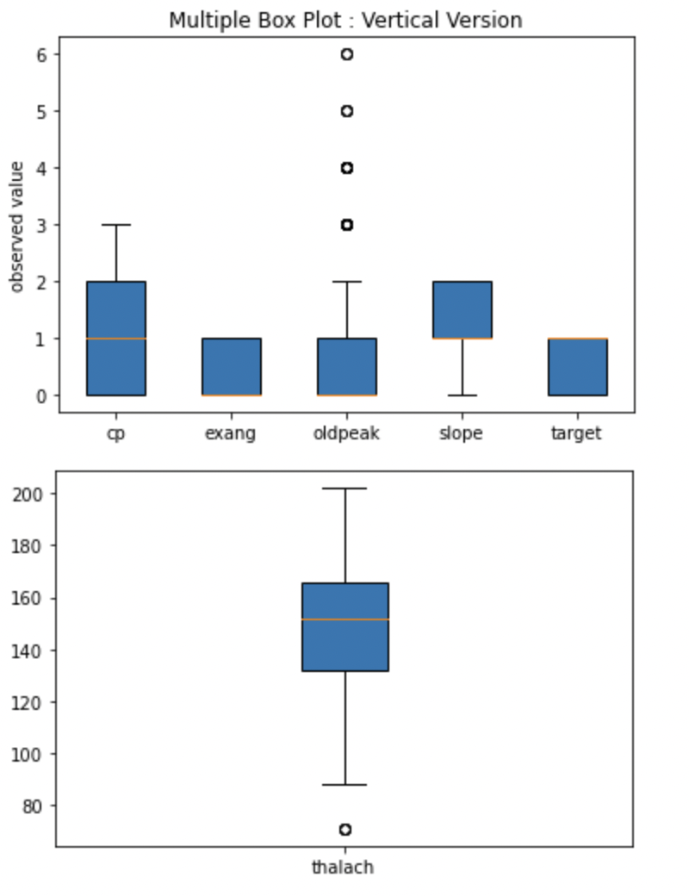
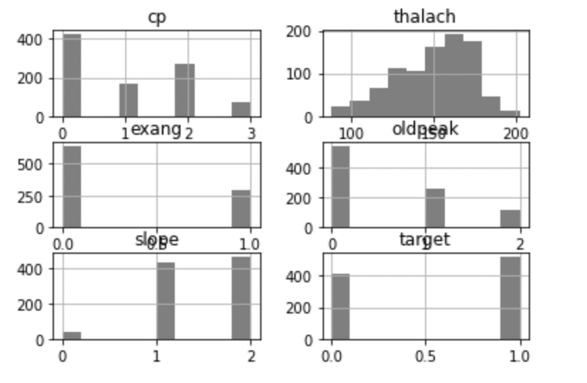
Visualizing Data
Visually analyzing the histogram shows that there exist no outliers. However, we can conclude by analyzing the boxplots to the left that there exist outliers in two of the boxplots.
Potential Reasons:
The oldpeak variable describes the depolarization and repolarization of the ventricles, so a higher ST value would result in a total artery blockage which is a rare and most dangerous type of heart disease to occur.
There are very few outliers in the thalach column, and the most probable cause explanation is due to an individual's lifestyle or age contributing to a lower heart rate.
Outliers will be handled by removing rows containing outliers.

Slide 5
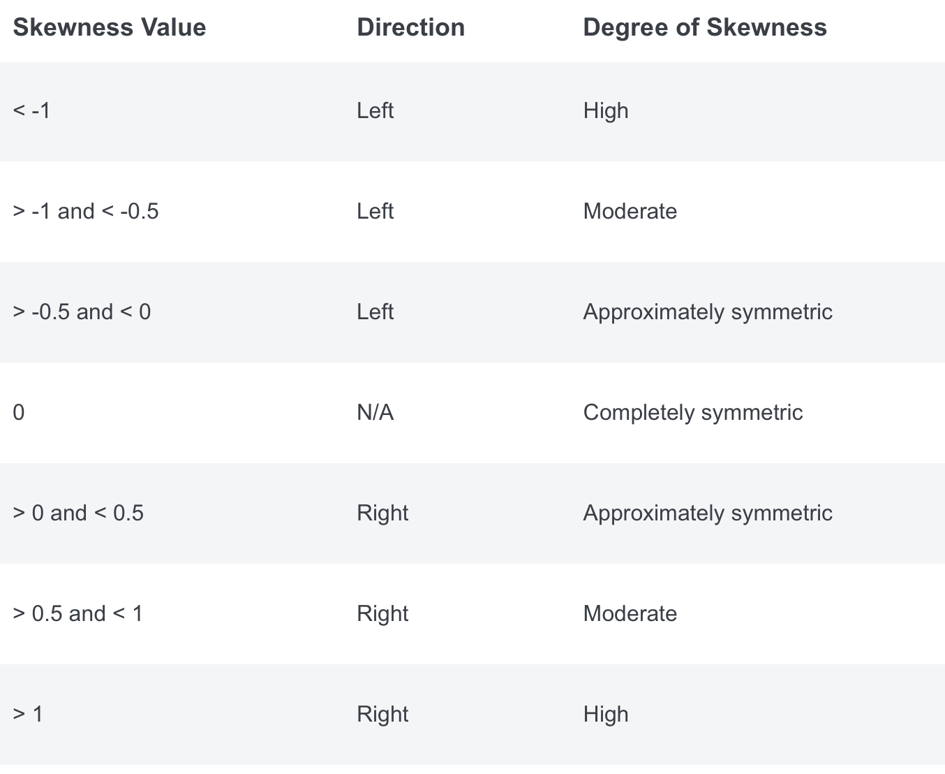
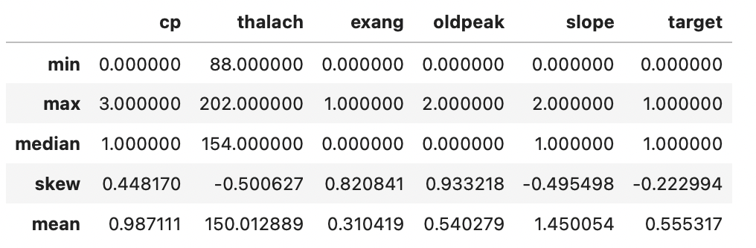
Variable Statistics
The following statistics (bottom left) describe the shape of the graph for each variable. The chart on the top left provides a general guide to determine the skewness of the distribution.
Based on the statistics, most distributions are moderately skewed, which is expected since all the variables have discrete values.

Slide 6
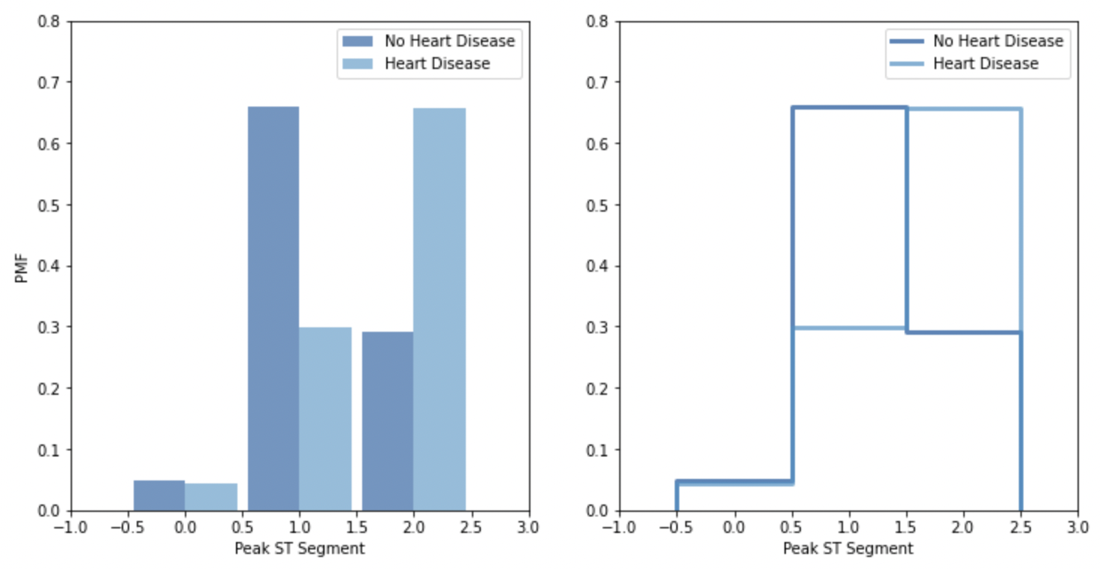
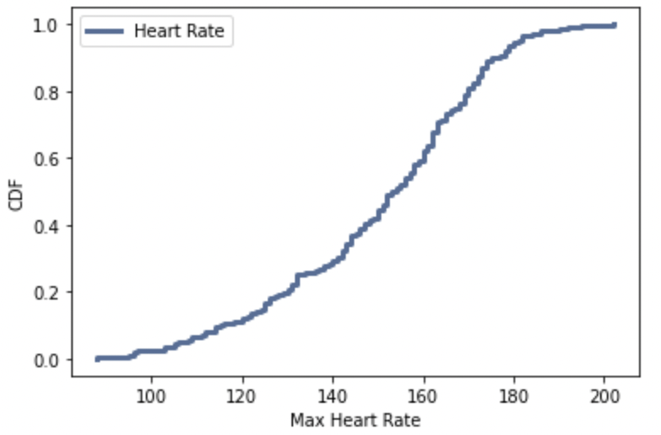
PMF/CDF
The plot (top right) shows the PMF of individuals with different peak exercise ST segment slope by splitting the dataset into whether an individual has heart disease (HD).
The graph suggests that people with level 1 peak ST segment tend to have lower chances of developing HD, while level 2 peak ST segment leads to higher HD in people.
The bottom graph illustrates the CDF plot with thalach variable (max heart rate). Based on the graph, approximately 40% of the individuals have a heart rate between 160 to 180, which is shockingly concerning considering a healthy heart rate is around 120. Perhaps heart rate is significant in determining HD.

Slide 7
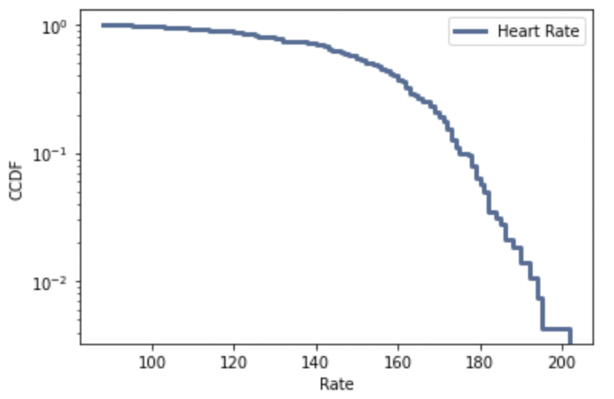
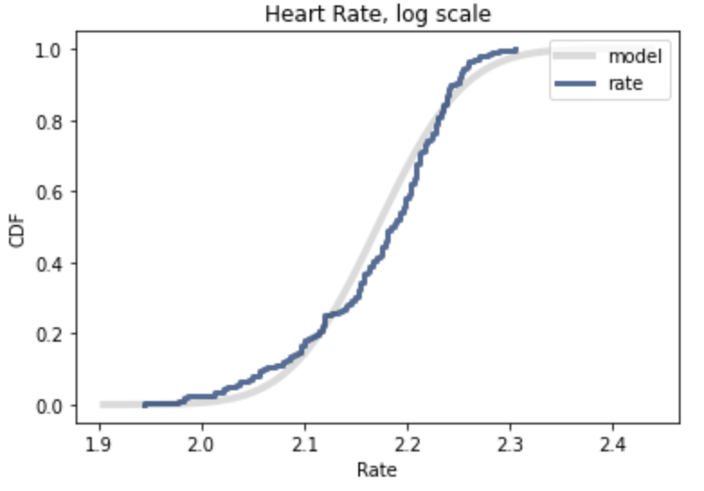
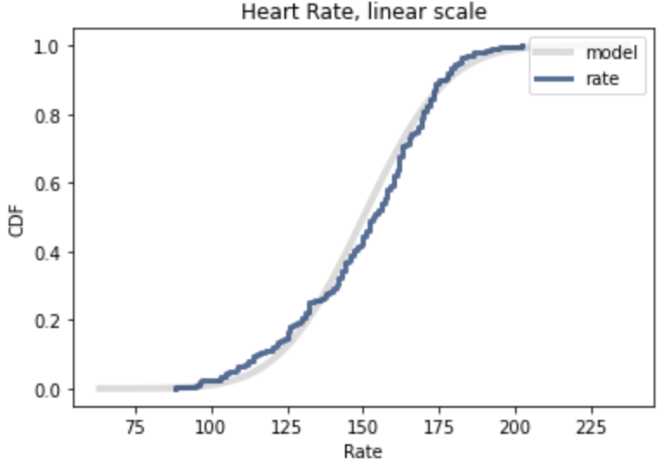
Analytical distribution
The left graph depicts an exponential distribution for heart rate, which is shaped like a curve indicating that the distribution is not a perfect model.
The middle graph shows a lognormal distribution for heart rate. While the logarithmic model covers a certain section of the predicted model, there exists a discrepancy between the values which can be improved. Therefore, lognormal distribution will not be a good model for our analysis.
The right graph shows normal probability plots for heart rate. It is apparent from the graph that normal probability is a better representation since the discrepancy is slower compared to lognormal distribution.

Slide 8
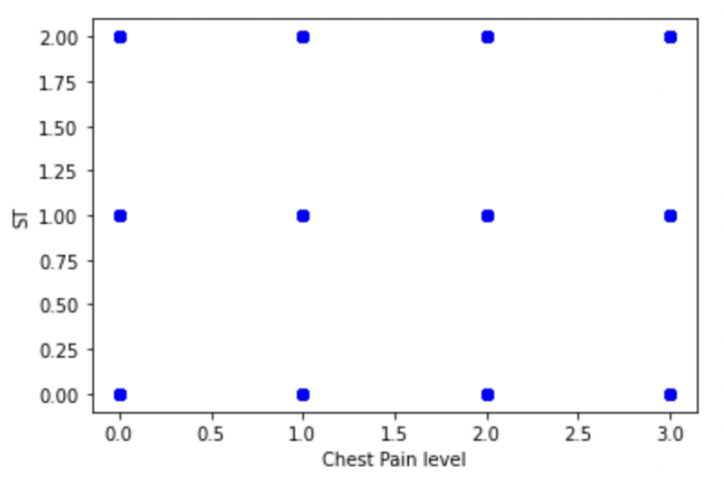
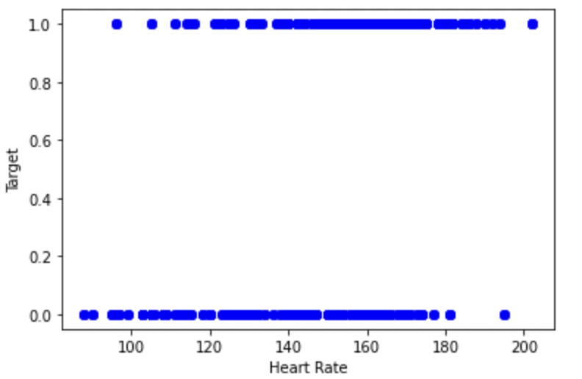
Scatter Plots
The following graphs show a linear correlation between the variables. The top right graph is a chest pain level(cp) vs ST (slope) scatter plot, and the bottom scatter plot shows the relationship between heart rate (thalach) and target (people with/without HD).
As expected, both plots do not have a linear relationship. Since most variables have discrete values (similar to rank), establishing a linear relationship will be challenging as the value will exist in one of the states (i.e., 0, 1, or 2).
Hence, a linear model or regression will not be ideal in our case.

Slide 9
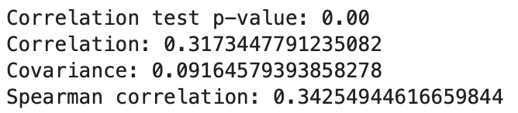
Hypothesis testing
Considering that our question is related to exploring variable relationships, conducting a correlation test seems like the ideal step.
The picture shows correlation statistics for peak exercise ST segment (slope) vs whether an individual has HD (target). From the results, we can see that the correlation value is 0.31 meaning there is a weak positive correlation between the two variables. The p-value is 0.00 indicating that the results are unlikely to occur by chance. As expected, the Spearman correlation value (0.342) is better than Pearson's correlation value (0.317)
The correlation test was performed for the target against all the other variables, I discovered that the p-value is 0.00 in all cases meaning the results are unlikely to occur by chance in all cases. The highest correlation value is 0.422 with Spearman's correlation of 0. 448 for chest pain (cp) vs target. (See python script for the result on Github)
Spearman’s correlation value is better in all the cases.

Slide 10
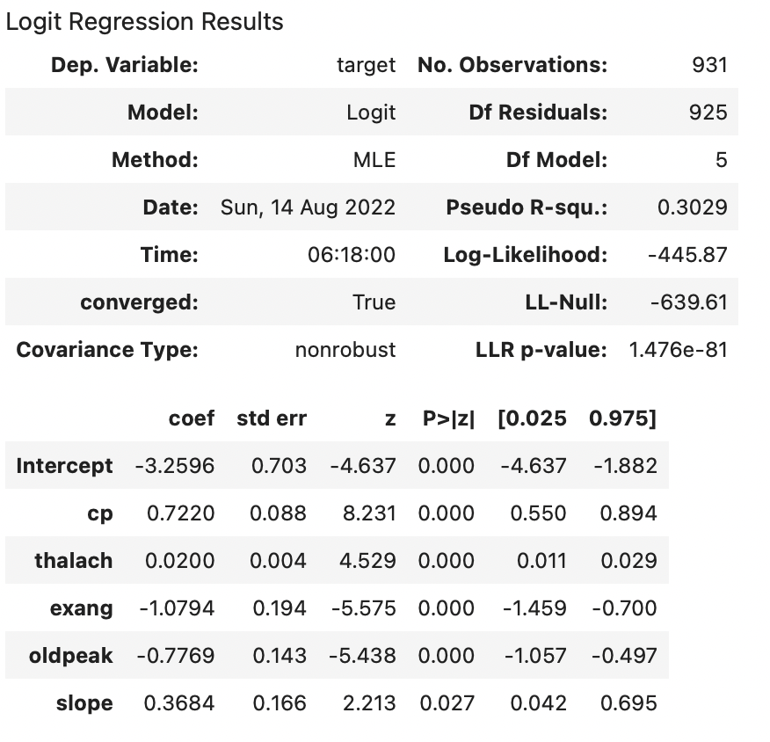
Regression analysis
Due to the discrete values (Boolean) for most of the variables in the dataset, logistic regression is a reasonable option to explore the relationship between the variables.
From the chart to the right, we can conclude all the variables are statistically significant with low p-values.
The coefficient for cp is the highest (0.72) followed by slope with 0.36. By raising the cp coef. value to the exponential, we get 2.03 indicating that people experiencing severe chest pain are twice as likely to have cardiovascular disease.

Slide 11
Reference
https://datagy.io/pandas-exploratory-data-analysis/
https://www.who.int/news-room/fact-sheets/detail/the-top-10-causes-of-death

